Slide 1
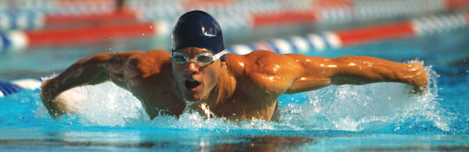
Chapter 4
The Pieces of the Body Puzzle:
A Regional Approach
Kinesiology Books Publisher 1

Slide 2
Table of Contents
Axial Skeleton
Head and neck Region
Appendicular Skeleton
Pectoral Girdle
Back Region
Scapulohumeral Region
Upper Limb
Pelvic Girdle
Lower Limb
Kinesiology Books Publisher 2

Slide 3
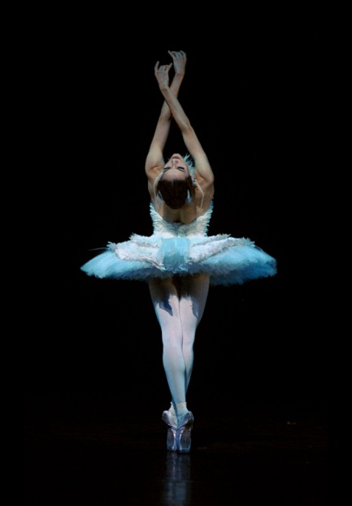
Axial Skeleton
Head and Neck Region
Back Region
Kinesiology Books Publisher 3

Slide 4
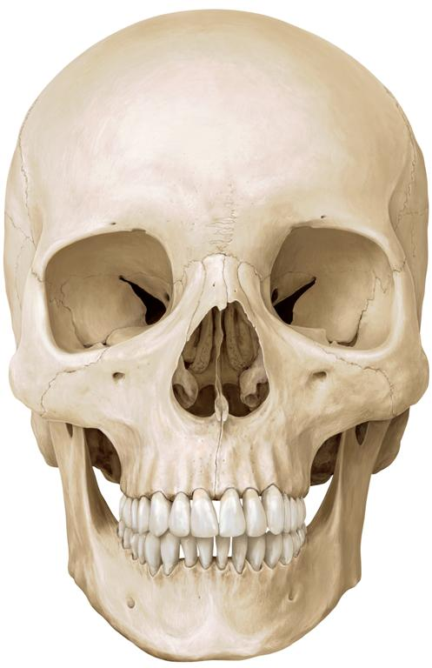
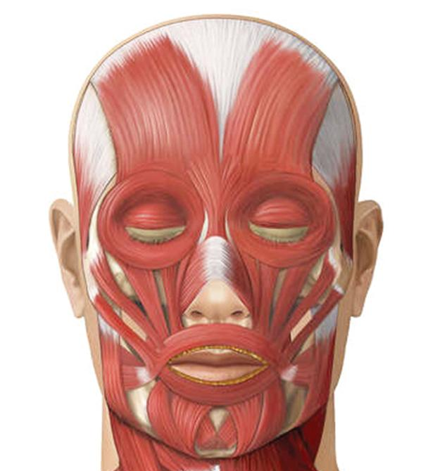
The Head and Neck Region
Skull
Facial Muscles
Kinesiology Books Publisher 4

Slide 5
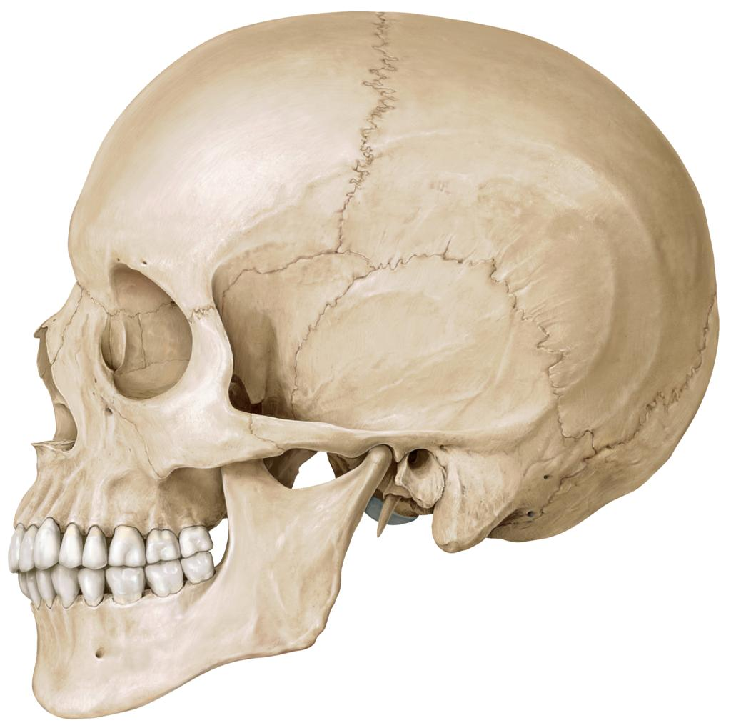
Skull: Calvaria
Formed by 5 curved flat bones
Protect the brain and the brain stem
May be fractured by blows to the skull
E.g. As a result of hitting the skull on the ice when playing hockey
Frontal
Parietal
Sphenoid
Temporal
Occipital
Kinesiology Books Publisher 5

Slide 6
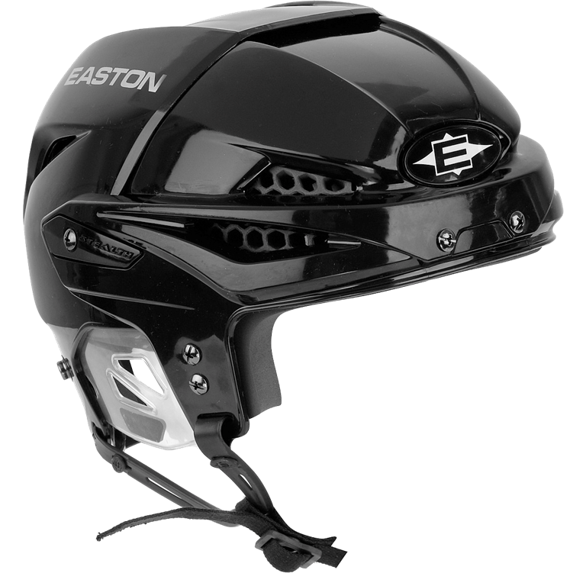
WRONG
Why Wear A Helmet?
To prevent a concussion
Brain injury due to shaking or jarring of the head
Brain bounces against the inside of the skull
Approximately 20% of reported concussions occur in organized sports
Kinesiology Books Publisher 6

Slide 7
Skull: Facial Bones
Lacrimal
Formed by 5 irregular bones
Give it its individuality
Provide protection for the eyes and air passages
Allow chewing and entry of food
Nasal
Zygomatic
Maxilla
Mandible
Kinesiology Books Publisher 7

Slide 8
Facial Muscles
Allow us to:
Change expression
Display emotion
Form words
Close eyes to keep them moist and prevent discomfort
Close mouth to chew
Orbicularis oculi
Orbicularis oris
Kinesiology Books Publisher 8

Slide 9
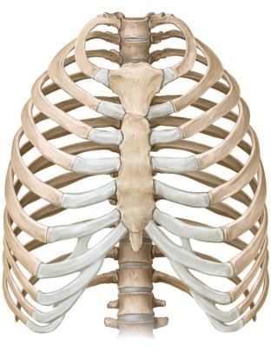
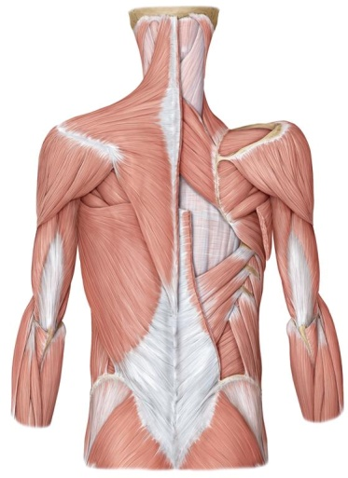
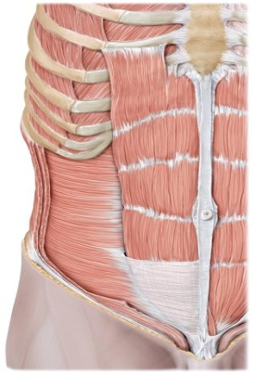
Back Region
Vertebral Column
Ribs and Sternum
Neck and Back Muscles
Abdominal Muscles
Kinesiology Books Publisher 9

Slide 10
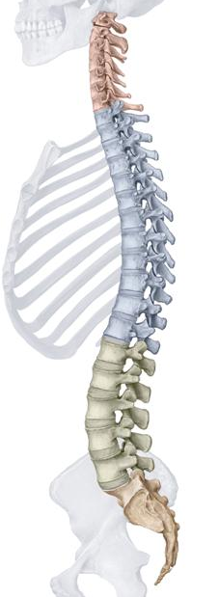
Vertebral Column
Back bone
Made up of 33 vertebrae arranged in a cylindrical column
Interspersed with intervertebral discs
Function:
Attachment for back muscles
Protects the spinal cord and nerves
Strong and flexible support; keeps body erect
Absorbs shock through the intervertebral discs
7 cervical vertebrae
(neck)
12 thoracic vertebrae
(chest)
5 lumbar vertebrae
(lower back)
1 sacrum = 5 fused vertebrae
(midline region of buttocks)
1 coccyx = 3 or 4 fused vertebrae
(tail bone)
Kinesiology Books Publisher 10

Slide 11
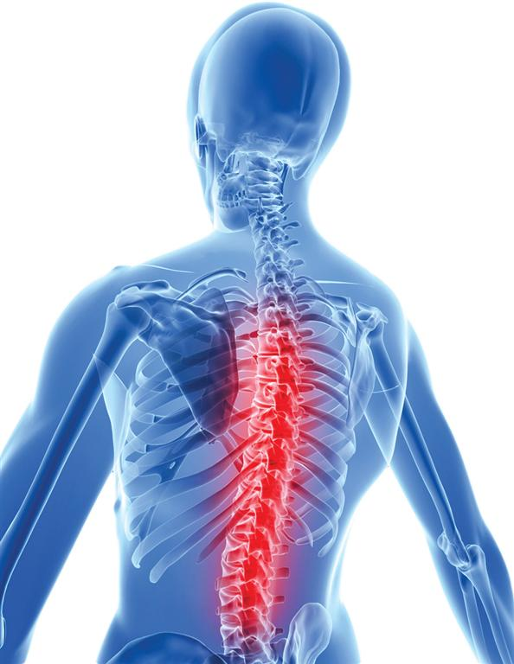
Herniated Disk
Involves the inside of the disc (nucleus pulposus) bulging out
Due to disruption of the annular fibres of the disc
May lead to nerve irritation and pain
Most commonly occur in the lower back
Repeated flexion (e.g., crunches), poor sitting posture, poor lifting technique
Kinesiology Books Publisher 11

Slide 12
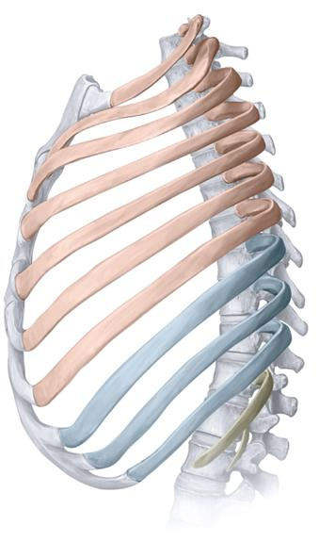
Ribs and Sternum
Typically 12 pairs of ribs
Made up of bone and costal cartilage
Curved and slightly twisted, ideal
Functions:
Give strength to chest cage and allow it to expand
Protect chest area
1 to 7,True ribs
(attach to vertebrae and sternum)
8 to 10, False ribs
(attach to sternum indirectly)
11 and 12, Floating ribs
(attached to vertebral column)
Kinesiology Books Publisher 12

