Slide 1
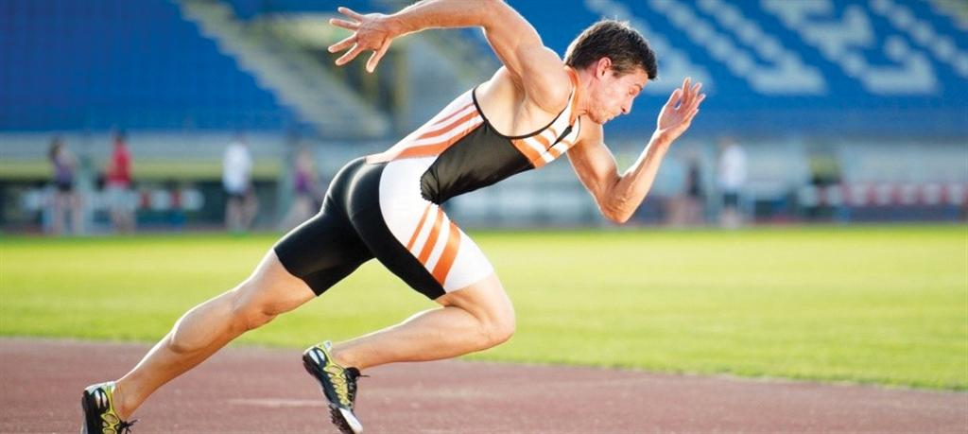
Chapter 9
The Science of Biomechanics
Kinesiology Books Publisher 1

Slide 2
Table of Contents
Types of Study
Quantitative vs Qualitative Analysis
Motion Concepts
Mass, Gravity, and Inertia
Kinematics Versus Kinetics
Types of Motion
Causes of Motion
Lever Systems and Motion Mechanics
Newton’s Laws of Motion
Fluid Dynamics
Law of Inertia
Law of Acceleration
Law of Action–Reaction
Fluid Drag Forces: The Dynamics of Air
Body Balance and Stability Control
Equilibrium
Balance
Stability
Qualitative Analysis of Human Motion
Error Detection and Correction
Observation of Performance
Analyzing a Skill
Skill Objective
Kinesiology Books Publisher 2

Slide 3
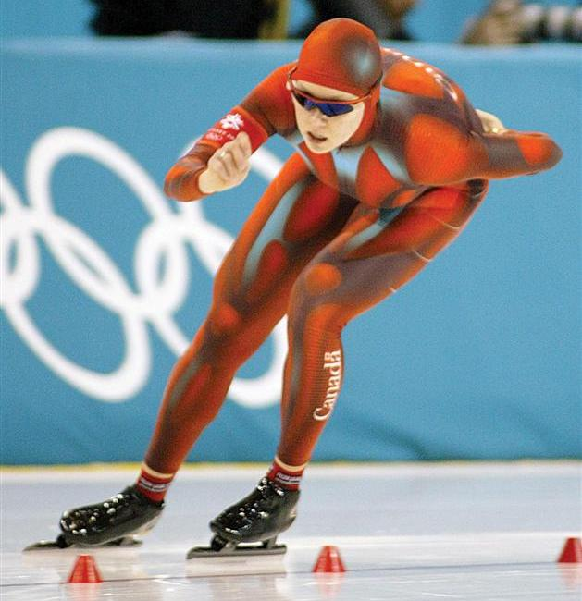
The Science of Biomechanics
Study of internal and external forces acting on human body and their effects
Relatively young
Extremely diverse and multifaceted
Contributes significantly to our knowledge of human movement
Kinesiology Books Publisher 3

Slide 4
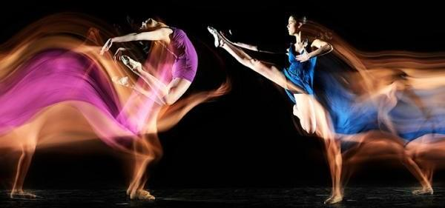
Types of Study
Quantitative versus Qualitative Analysis
Kinematics Versus Kinetics
Kinesiology Books Publisher 4

Slide 5
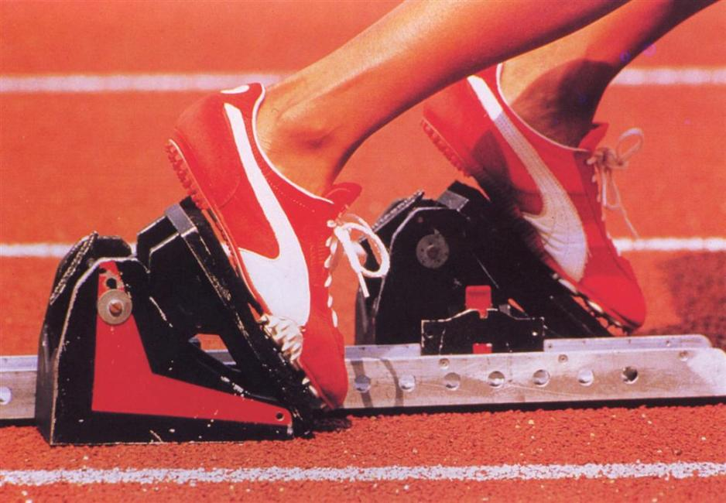
Quantitative vs. Qualitative Analysis
Depends on
Environment
Availability of high-tech equipment
Kinesiology Books Publisher 5

Slide 6
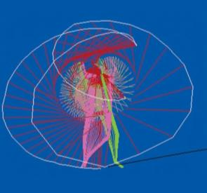
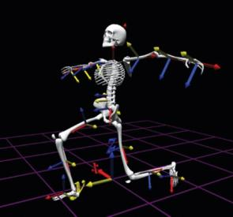
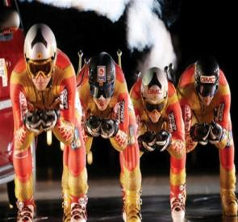
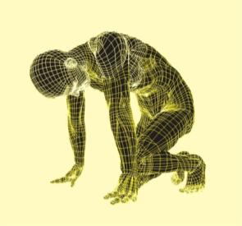
Quantitative Analysis
Using high-tech instrumentation
Usually intended for researchers
Measuring variables to optimize athletic performance
Foot forces on sprinter’s blog
Muscle contraction sequence during running
3-D body segment movements during a high jump
Kinesiology Books Publisher 6

Slide 7
Kinesiology Books Publisher 7

Slide 8
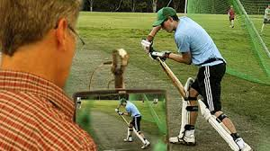
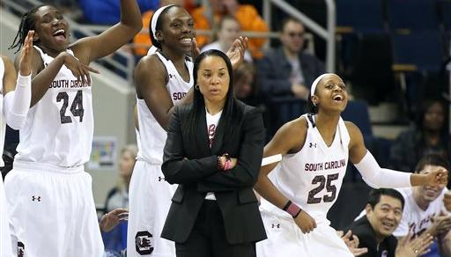
Qualitative Analysis
Using sight and hearing
Usually done by coaches and teachers
To identify and correct errors: “Observe, analyze and correct.”
Requires framework and a set of principles
Kinesiology Books Publisher 8

Slide 9
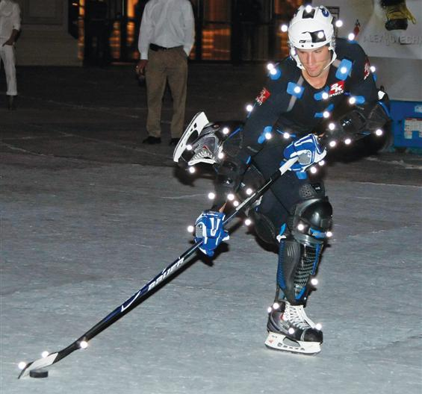
Kinematic vs. Kinetics
Two ways to describe human motion
Without reference to forces causing motion
Describing motion in terms of forces that cause it
Kinesiology Books Publisher 9

Slide 10
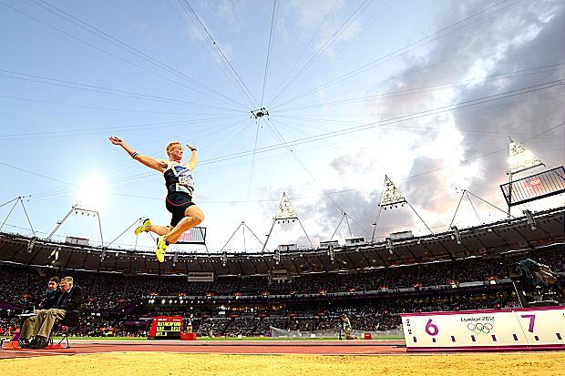
Kinematics
Describing human motion without its forces
Focusing on motion’s spatial and timing characteristics
Measurements:
Time
Displacement
Velocity
Acceleration
Kinesiology Books Publisher 10

Slide 11
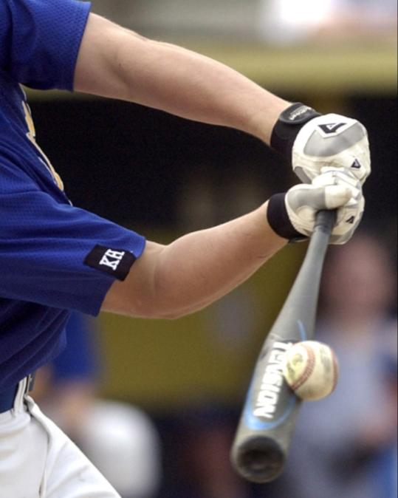
Kinetics
Describing forces leading to motion
Internal forces
Muscles pulling on bones
Bone-on-bone, inside joints
External forces acting on the body
Without contact (e.g., gravity)
From contact with ground, opponent or equipment
Kinesiology Books Publisher 11

Slide 12
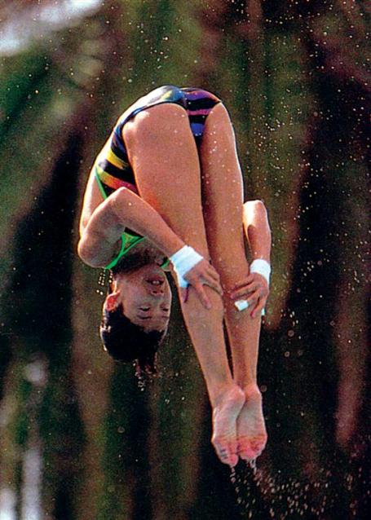
Models of Human Motion
Understanding and observing human movements is complex
All body tissues undergo shape deformation
Most movements occur in three dimensions
3 models, simplify the study of human movements:
Particle model
Stick figure model
Rigid body segment model
Kinesiology Books Publisher 12

Slide 13
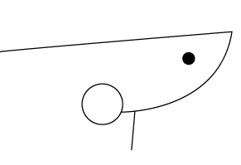
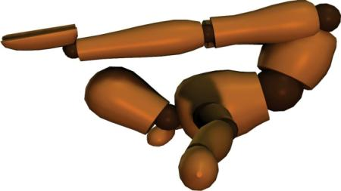
Particle Model
Dot represents centre of mass
Stick Figure Model
Body segments = sticks
Rigid Body Segment Model
Body segments = irregular 3-D volume
Used when body or object is airborne and in flight
i.e., projectile motion
Used when body in contact with other objects
Describe gross motor skills in 2-D
Used for sophisticated 3-D analyses
Includes shape deformation of body segments
Kinesiology Books Publisher 13

Slide 14
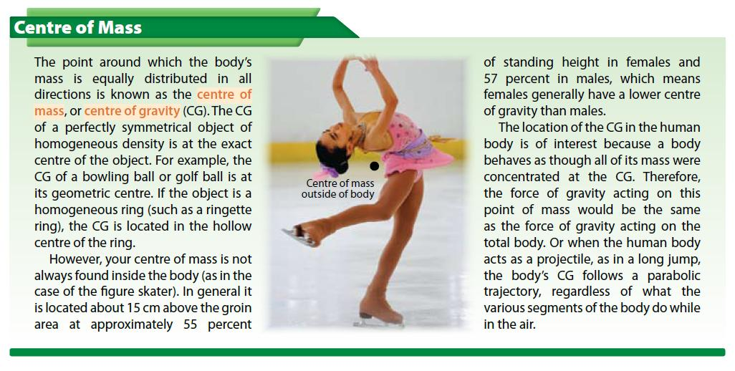
Kinesiology Books Publisher 14

Slide 15
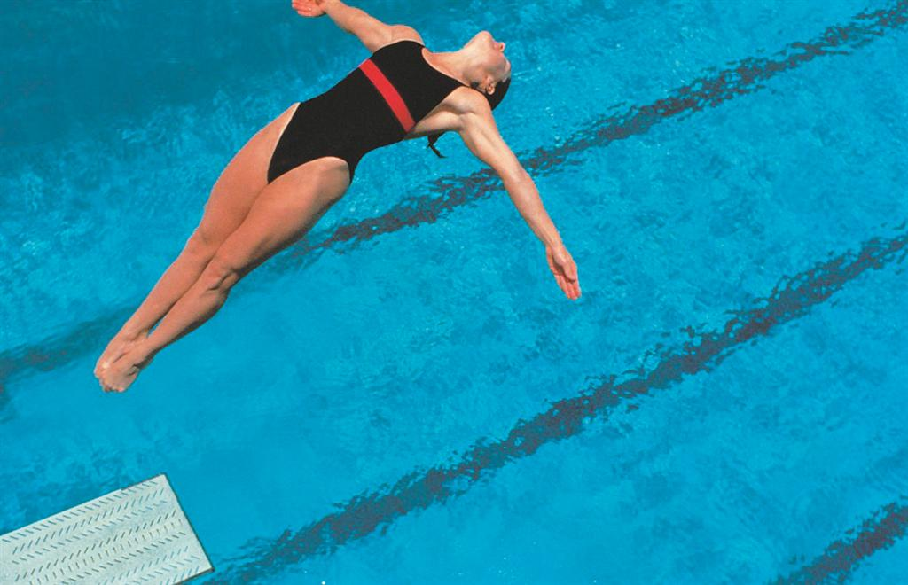
Motion Concepts
Mass, Gravity, and Inertia
Types of Motion
Causes of Motion
Lever Systems and Motion Mechanics
Kinesiology Books Publisher 15

Slide 16
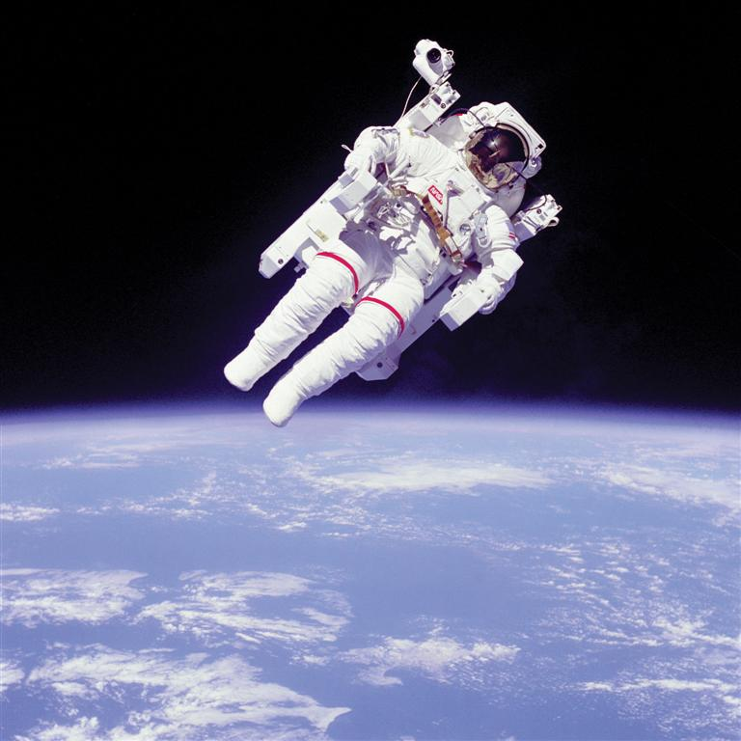
Mass, Gravity, Inertia
Mass
Amount of matter in an object
Objects are reluctant to go change state of motion
A measure of inertia
Moment of Inertia
Reluctance of rotating object to change state of motion
Depends on mass and its distribution around axis of rotation
Gravity
Force of attraction between two bodies
E.g., human body and planet earth
Kinesiology Books Publisher 16

Slide 17
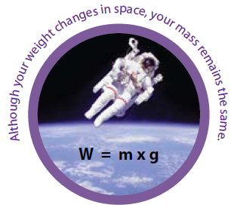
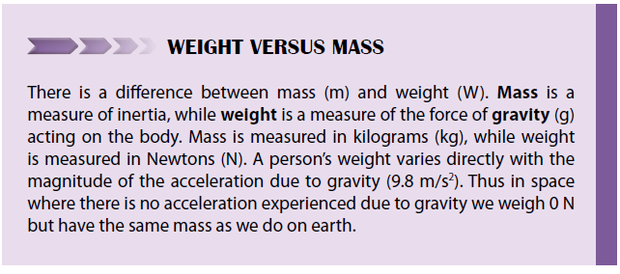
Kinesiology Books Publisher 17

Slide 18
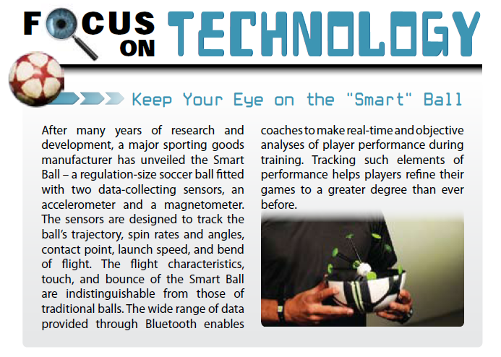
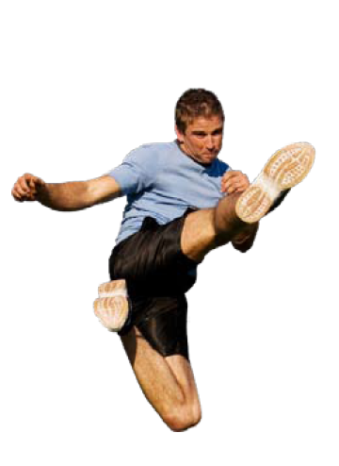
Kinesiology Books Publisher 18

Slide 19
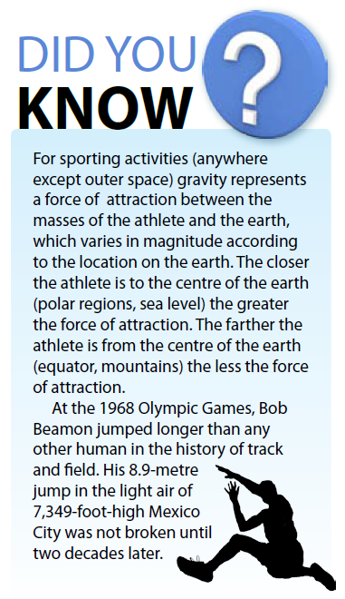
Kinesiology Books Publisher 19

Slide 20
Types of Motion
Human movement composed of a number of fundamental types of motion:
Linear motion / translation
Angular motion / rotation
General motion
Kinesiology Books Publisher 20

Slide 21
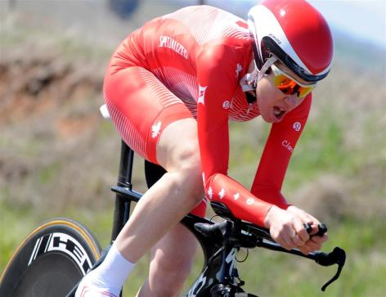
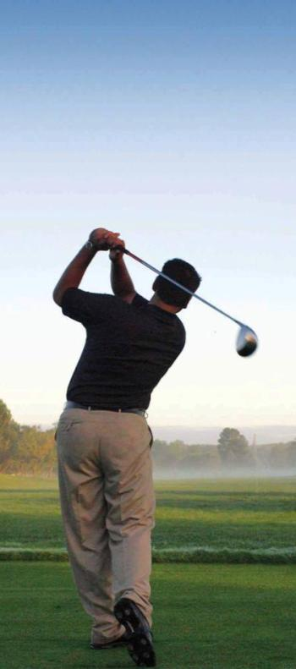
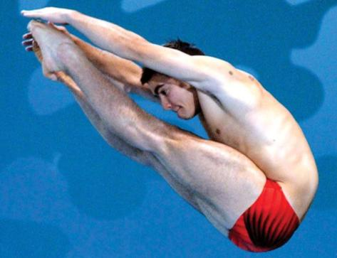
All body parts move same distance and direction, at the same time
Translation: linear motion of the whole body
Linear motion
Angular motion
General motion
Body / segments move linearly and rotate at the same time
True for most athletic and every day activities
E.g., gymnastics floor routine, diver falling downward and at the same time rotating in a somersault
Body moves on a circular path and rotates about axis of rotation
Body segments rotate about their joints
E.g., twisting somersault
Kinesiology Books Publisher 21

Slide 22
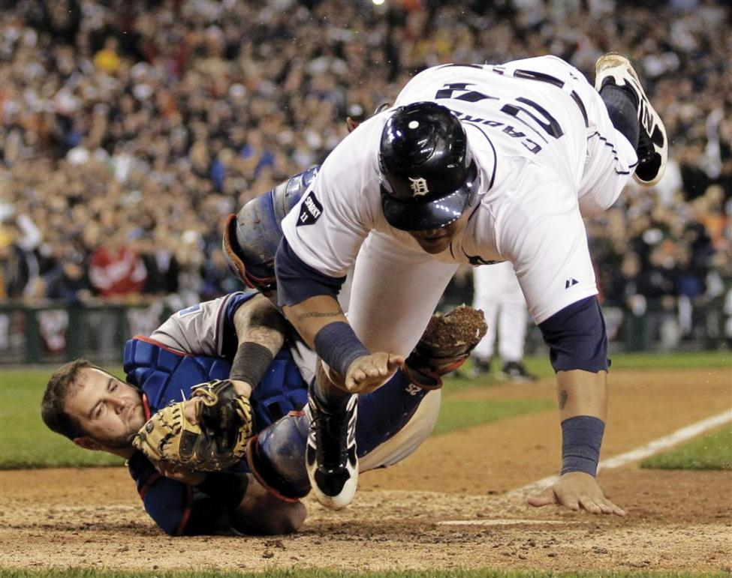
Causes of Motion
Application of internal or external forces
Force is any action, push or pull, that tends to cause an object to change is state of motion by experiencing acceleration or as state of constant velocity
Linear motion = force acting on centre of mass/ pivot point
Angular motion = force not acting on centre of mass/ pivot point and result in torque (moment of force)
Kinesiology Books Publisher 22

Slide 23
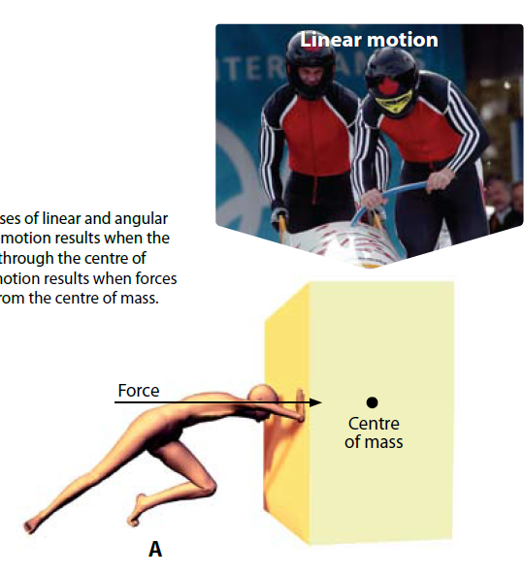
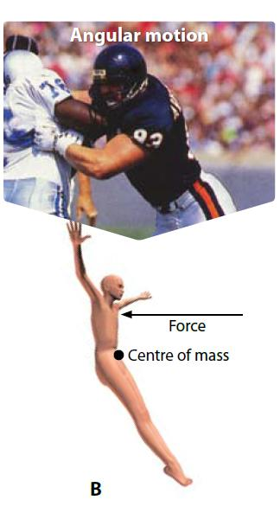
Kinesiology Books Publisher 23

Slide 24
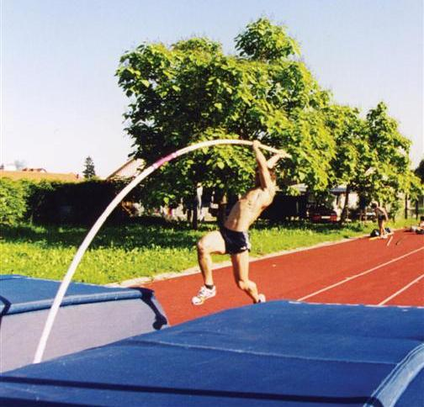
Lever systems and Motion Mechanics
Lever system
Mechanical device performing angular motion
Components:
Axis of rotation
Fulcrum (pivot)
Lever attached to fulcrum
Human muscles, bones and joint work together as lever systems
Kinesiology Books Publisher 24

Slide 25
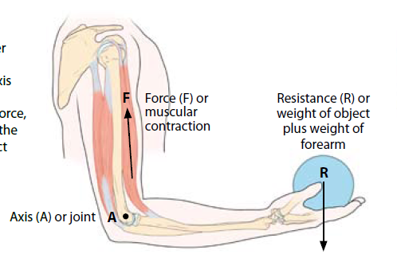
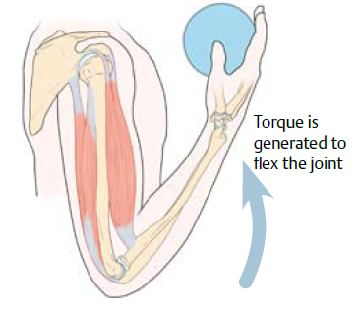
Kinesiology Books Publisher 25

Slide 26
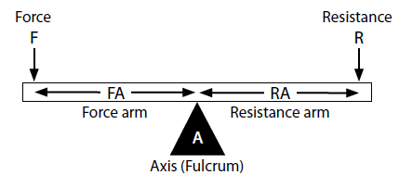
How Do Levers Work
Force is applied and if greater than resistance
Rotation at the axis / fulcrum occurs
To determine force amount, consider the length of force arm and resistance arm
Kinesiology Books Publisher 26

Slide 27
How Do Levers Work
When lever rotate around and axis / fulcrum:
Moment of force or torque is produced
How much torque occurs?
Therefore, with a longer force arm:
Less force is needed
Greater torque is produced
Kinesiology Books Publisher 27

Slide 28
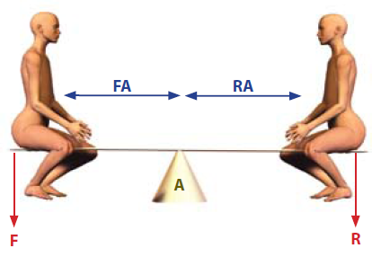
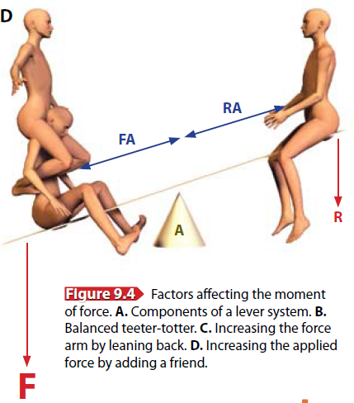
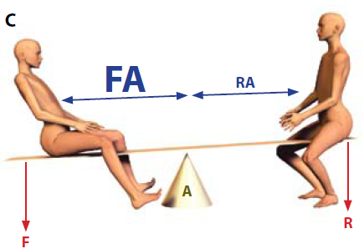
No rotation: F=R, FA=RA
Rotation: F>R, FA=RA
How do you rotate teeter-totter in your direction?
Rotation: F=R, FA>RA
Kinesiology Books Publisher 28
Kinesiology Books Publisher 28

Slide 29
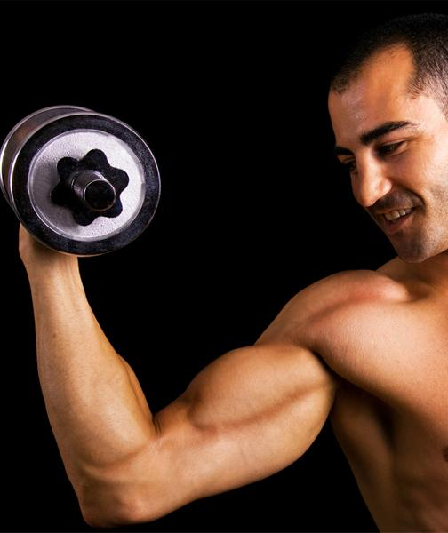
Types of Levers
Levers perform different functions
Three basic types of lever exist
First class
Second class
Third class
Differ based on mechanics and how these components are positioned
Axis
Resistance
Force
Kinesiology Books Publisher 29

Slide 30
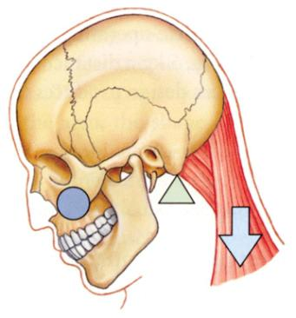
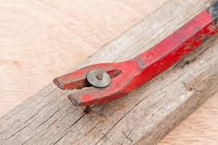
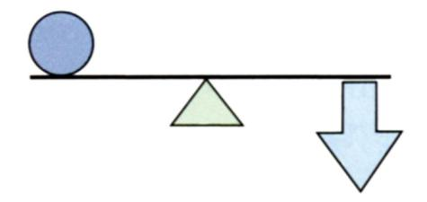
First Class Levers
Applied force and resistance on opposite side of axis, at un/equal distance from one another
Example: crowbar
Human body: head flexion
R
Resistance
A
A
F
Force
Kinesiology Books Publisher 30

Slide 31
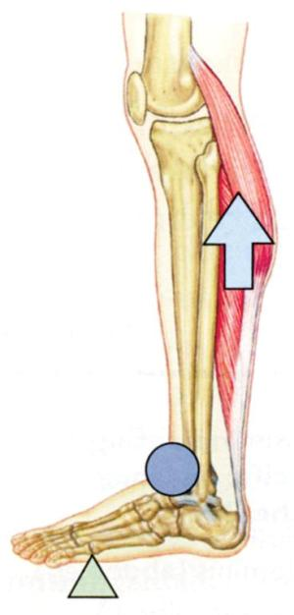
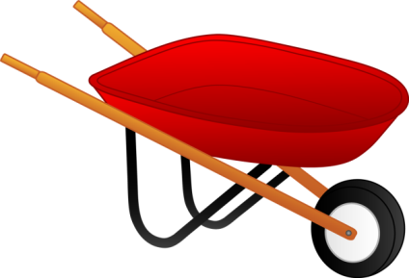
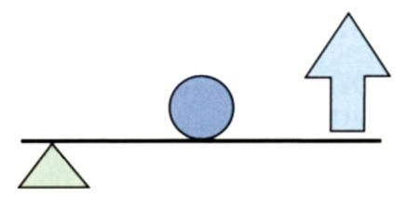
Second Class Levers
Applied force and resistance on same side of axis; resistance closer to axis
Example: wheelbarrow
Human body - hard to find: toe raise
Resistance
R
F
Force
A
A
Kinesiology Books Publisher 31

Slide 32
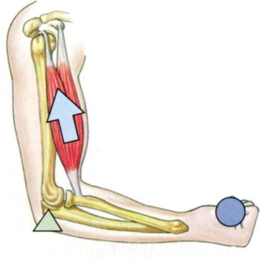
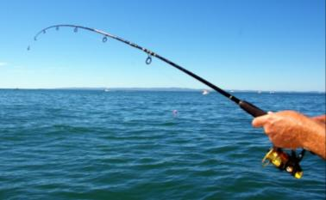
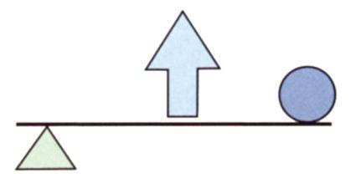
Third Class Levers
Applied force and resistance on same side of axis; force closer to the axis
Example: fishing
Human body – many: forearm flexion
Resistance
F
R
Force
A
A
Kinesiology Books Publisher 32

Slide 33
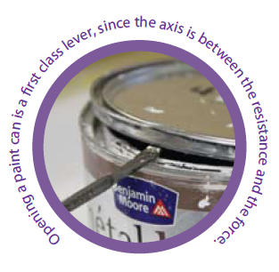
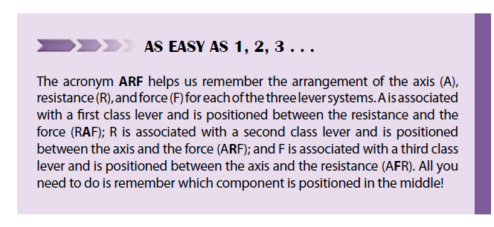
Kinesiology Books Publisher 33

Slide 34
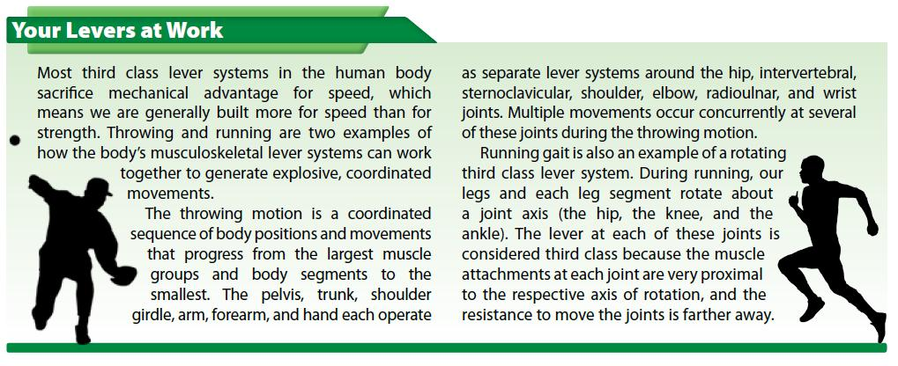
Kinesiology Books Publisher 34

Slide 35
Newton’s Laws of Motion
Law of Inertia
Law of Acceleration
Law of Action–Reaction
Kinesiology Books Publisher 35

Slide 36
Sir Isaac Newton
300 years ago
Explained effect of forces acting on an object
Through 3 laws
Kinesiology Books Publisher 36

Slide 37
Law of Inertia
Newton’s First Law
“Objects will not change their state of motion unless acted on by an unbalanced external force”
Kinesiology Books Publisher 37

Slide 38
Law of Acceleration
Newton’s Second Law
“Objects will experience a change in velocity or acceleration proportional to the unbalanced external force”
Kinesiology Books Publisher 38

Slide 39
Same mass
Same force
Same acceleration
Kinesiology Books Publisher 39

Slide 40
Law of Action-Reaction
Newton’s Third Law
“For every action there is an equal and opposite reaction; forces act in pairs that are equal in magnitude and opposite in direction”
Kinesiology Books Publisher 40

Slide 41
Kinesiology Books Publisher 41

Slide 42
Fluid Dynamics
Fluid Drag Forces: The Dynamics of Air
Kinesiology Books Publisher 42

Slide 43
Fluid Dynamics
Knowledge of the forces generated by a fluid environment such as
Water
Air
Water + Air
All athletic event take place in a fluid environment
Unaffected: gymnastics, dancing
Affected: running, cycling, skiing, speed skating, swimming, badminton, baseball, etc.
Kinesiology Books Publisher 43

Slide 45
Drag Forces: Air
Drag is a type of fluid force
Profile drag; caused by object’s size and shape
Surface drag; cause by object’s roughness
Acts in opposite direction to body’s travel and slows it down relative to body’s
Velocity
Size and shape
Roughness
Fast-speed sports especially affected
↑ velocity = ↑ drag² (10x faster, 100 x more drag)
Kinesiology Books Publisher 45

Slide 46
Surface Drag
Body size and surface roughness = surface drag
Boundary layer
Thin layer of fluid adjacent to skin and carried along with body’s motion, towing along outer fluid layers
Laminar flow
Small, streamlined, smooth, slow-moving bodies
Smooth, layered flow pattern with no disturbance
Turbulent flow
Most human activities
Disturbed flow pattern that changes flow conditions
Kinesiology Books Publisher 46

Slide 47
Laminar flow
Turbulent flow
Kinesiology Books Publisher 47

Slide 48
Kinesiology Books Publisher 48

Slide 49
Profile Drag
Main form of drag in fast-moving sports
Characterized by turbulent flow
Velocity of air flow past object is too fast for air to follow body’s contour
Backflow occurs at object’s surface causing large, turbulent low-pressure zone behind the body
This zone is continually formed and increases object’s work
Profile drag-reducing strategies
↓ frontal surface area (e.g., lugers are supine)
↓ sources of turbulence (e.g., speed skaters with arms behind back)
Drafting
Kinesiology Books Publisher 49

Slide 50
Magnus Effect
A rotating body carries a boundary layer that interacts with surrounding air
Boundary layer flow opposite to relative airflow
Air is slowed by friction
Zone of increased pressure created
Boundary layer flow same as relative airflow
Air is not slowed down
Zone of increased pressure created
Net difference in pressure on opposite sides of rotating object = Magnus force
Magnus effect is mostly found in ping pong, tennis, soccer, and baseball
Kinesiology Books Publisher 50

Slide 51
Top spin: downwards Magnus force
Back spin: upwards Magnus force
Kinesiology Books Publisher 51

Slide 52
Kinesiology Books Publisher 52

Slide 53
Body Balance and Stability Control
Equilibrium
Balance
Stability
Kinesiology Books Publisher 53

Slide 54
Equilibrium
Equilibrium is a state of a system not experiencing change in direction and speed
Static equilibrium: body’s at rest
Dynamic equilibrium: body’s moving at constant velocity
Kinesiology Books Publisher 54

Slide 55
Balance
Balance: process where body’s equilibrium is controlled for a purpose
Affected by two factors:
Base of support; area of contact between body and surface
Wider base, greater balance
Location of line of gravity; imagery vertical line that passes through centre of mass
Has to pass through base of support for balance
Kinesiology Books Publisher 55

Slide 56
Stability
Stability is a measure of the difficulty with which equilibrium can be disturbed
Net internal force required to overcome static or dynamic equilibrium
During critical performance times there is a trade-off between maximizing stability and acquiring speed
Kinesiology Books Publisher 56

Slide 57
↑Stability
Static Equilibrium
↑ base size
↑ body size
Lower centre of gravity
↑ distance between gravity line intersecting base and outside base edge
Kinesiology Books Publisher 57

Slide 58
Kinesiology Books Publisher 58

Slide 59
↑Stability
Dynamic Equilibrium
Widen base towards oncoming external horizontal force
Move centre of gravity towards base edge during quick acceleration
Shift centre of gravity towards oncoming force
Use reflex movement to regain loss of balance
Kinesiology Books Publisher 59

Slide 60
Kinesiology Books Publisher 60

Slide 61



Kinesiology Books Publisher 61

Slide 62
Qualitative Analysis of Human Motion
Skill Objective
Analyzing a Skill
Observation of Performance
Error Detection and Correction

Slide 63
Qualitative Analysis
Subjective yet systematic evaluation of human motion without measuring and using numbers
Based on visual observation or video recording
Allows discovery of movement tendencies and generates immediate and specific feedback
Depends on coach’s understanding of skill
Based on a model integrating 4 aspects of quality instruction
Kinesiology Books Publisher 63

Slide 64
Kinesiology Books Publisher 64

Slide 65
Skill Objective
Can be described and identified for all skills
E.g., blocking a lineman
Secondary objectives may exist, referring to speed or accuracy required
Skills with similar overall objectives are governed by similar biomechanical principles
Throwing, striking, kicking object for maximal horizontal surface
Kinesiology Books Publisher 65

Slide 66
Analyzing Skill
Dividing skill into phases
Should make sense to the coach and how the skill is being defined and taught
Identifying key movements for each phase
Their execution determines successful accomplishment of biomechanical purpose of the phase and overall performance of the skill
Kinesiology Books Publisher 66

Slide 67
Kinesiology Books Publisher 67

Slide 68
Observation of Performance
Difficult task because of skill speed
Observation plan beforehand identifies what, why, where and how observation will occur
Coaches must use vision (dominant), hearing and feeling as well as look for tracks and traces
Confirm observation accuracy with athlete and video recording (if possible)
Kinesiology Books Publisher 68

Slide 69
Error Detection and Correction
Error sources
Mental: concentration lapse or fear
Physical: lack of strength, poor habits
Detection is visual via direct observation video analysis, or traces/marks observation
Correction
Should keep in mind athlete's physical and mental abilities, competition level, age and development level
Verbal, demonstration, video
Ongoing; 1-2 errors at a time starting with earlier
Kinesiology Books Publisher 69

Slide 70
Putting It All Together
Biomechanics is the physics of human movement with the main goal to optimize performance by focusing on movement kinematics and kinetics
Motion results from internal and external forces in ways that can be understood via Newton’s laws
Fluid affects athletic performance via surface and profile drag and Magnus effect
By manipulating base and centre of gravity characteristics athletes can increase stability and reach equilibrium
Coaches and athletes use qualitative analysis to evaluate skills and detect and correct errors
Kinesiology Books Publisher 70

