Slide 1
CHAPTER 4: LEISURE, RECREATION, AND WELLNESS
“Don’t drop out, drop in.
Don’t cop out, compete.
Don’t exit, excel.”
Pierre Elliott Trudeau

Slide 2
Contents
Leisure versus Recreation
Historical Development of Recreation: A Brief Overview
Benefits of Recreation
Factors Affecting Our Recreational Interests and Pursuits
Barriers to Recreation and Leisure
Health and Wellness

Slide 3
Introduction
After reading this chapter, you should have knowledge about the following:
The definition of leisure, recreation, and wellness
The evolution of recreation in society
The benefits of and potential barriers to recreation opportunities
How to become physically active

Slide 4
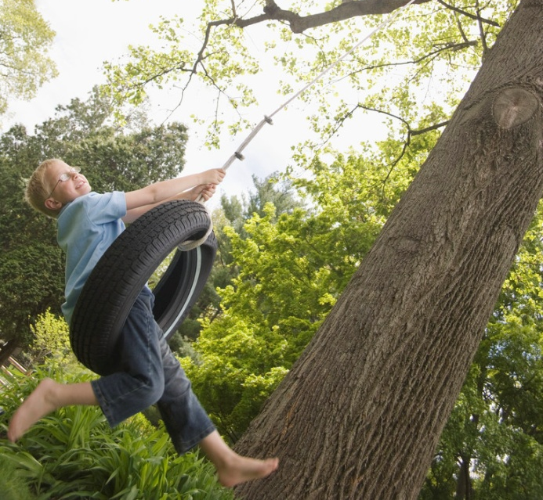
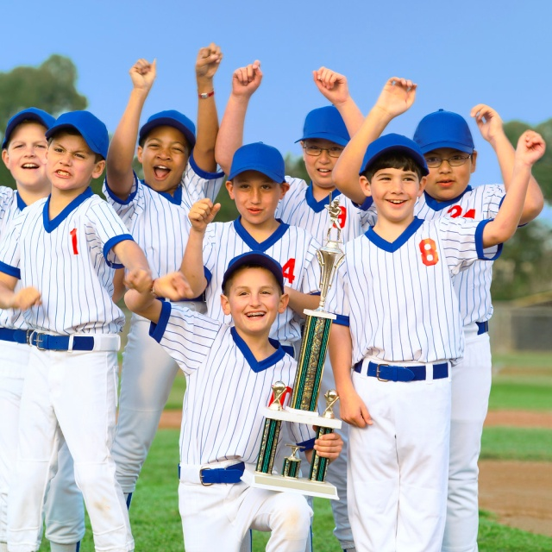
Leisure versus Recreation

Slide 5
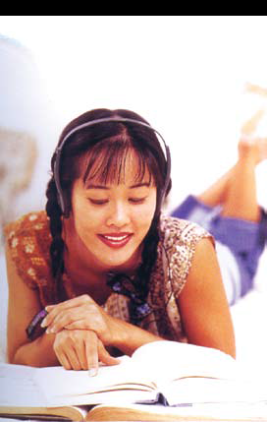
Leisure
Free time that can be spent as you see fit
Activities making up your unstructured free time
Many different possibilities
Not necessarily planned use of time,
but not necessarily wasted time
Body’s chance to rejuvenate itself

Slide 6
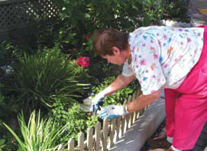
Recreation
Participation in an activity that you enjoy
An activity that will improve us or restore us in some way
E.g., playing sports, watching TV, downloading music, or playing video games, cooking and baking, gardening

Slide 7
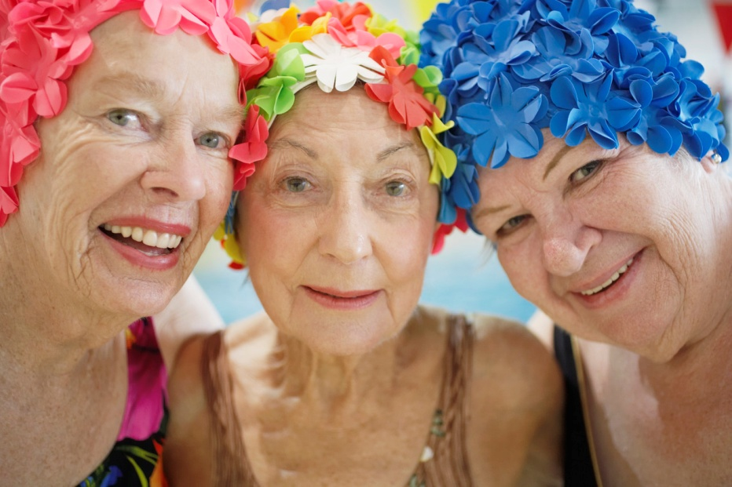
Historical Development of Recreation: A Brief Overview

Slide 8
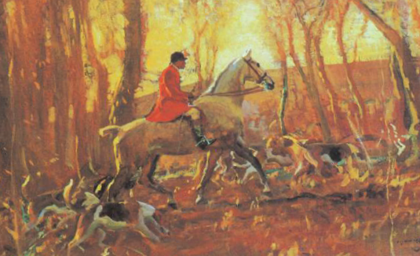
Renaissance Period (1350–1600)
Upper-class
Painting, music, literature, science, and education
Well-educated man could ride, fence, dance, and paint
Great cultural movement in the arts and education

Slide 9
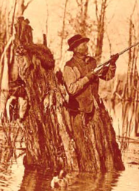
Reformation Period (1500s–1600s)
Protestant work ethic introduced to colonial America
Recreation and leisure were earned through daily hard work
“Work before play”
Ample time for recreation and leisure = lazy and a loafer

Slide 10
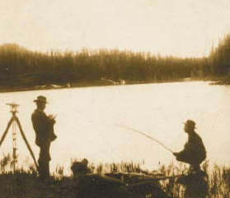
Industrial Revolution (1700–1900)
Working-class
No time or energy
Few leisure opportunities
Visiting the taverns or pubs
Middle class
Modeled upper class
Playing the piano, singing, and drama
Upper class
Enjoyed many forms of recreation
Bird watching, fishing, cricket, polo, and hunting

Slide 11
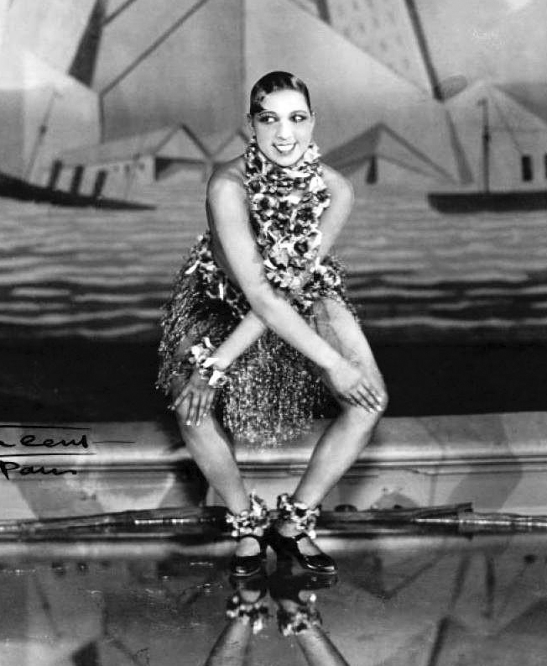
Roaring 20s
People began to recognize the need to enjoy leisure time
Hard work followed by deserved recreation and leisure
Gambling
Touring in the newly invented automobile
The Charleston in illegal after-hours clubs
Jazz

Slide 12
Depression Years (1929–1945)
Recreation became less formal
People came together
Played their musical instruments
Had picnics at the local beaches
Went swimming
Conducted square dances
Made ice cream were the norm
Big bands and swing music were popular
Attending the movie theatres (with sound)

