Slide 1
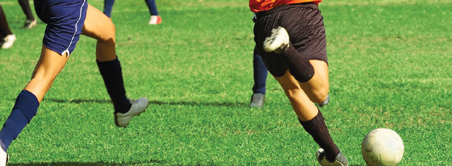
Chapter 5
Muscle Structure and Function
Kinesiology Books Publisher 1

Slide 2
Table of Contents
Skeletal Muscle
Nerve–Muscle Interaction and Adaptation to Exercise
Types of Human Muscle
Properties
Muscle Teamwork
Structure
Muscle Fibre Types
Motor Unit
Intramuscle Coordination
Intermuscle Coordination
Sport-Specific Training
Muscle’s Adaptation to Strength Training
Kinesiology Books Publisher 2

Slide 3
Types of Human Muscle
~660 muscles
~½ body weight
Various structures and types
Numerous functions
Ventilation
Digestion
Pumping of blood
Movement
Skeletal
Cardiac
Smooth
Kinesiology Books Publisher 3

Slide 4
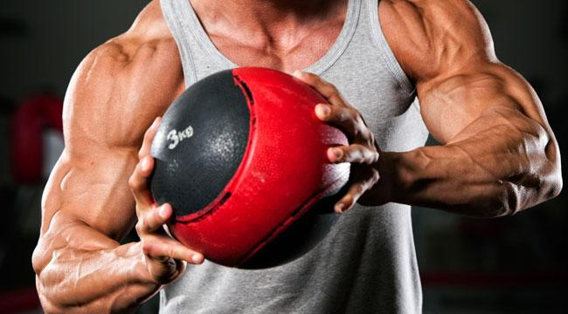
Skeletal Muscle
Properties
Teamwork
Structure
Fibre Types
Kinesiology Books Publisher 4

Slide 5
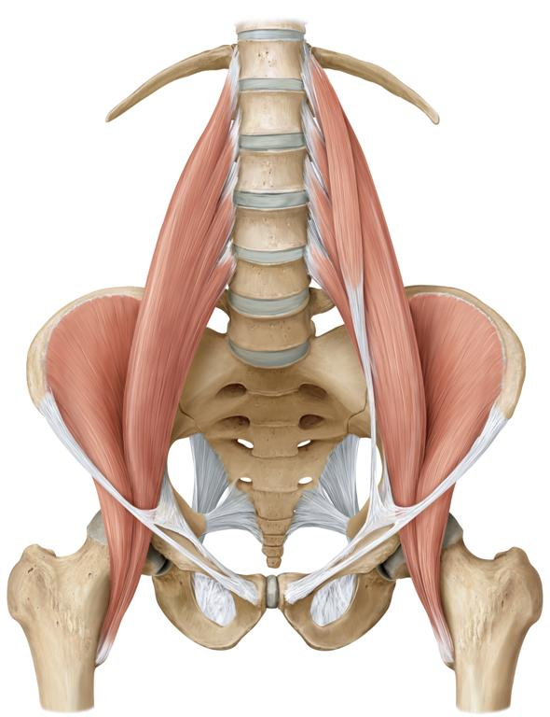
Properties
Formed by muscle fibres (cells) bound together by connective tissue
Linked to bone by bundles of collagen fibres (tendons)
Shorten during contraction and pull onto tendons and bones to create movement
Capable of rapid contraction
Fatigue as a result of intensive activity
Kinesiology Books Publisher 5

Slide 6
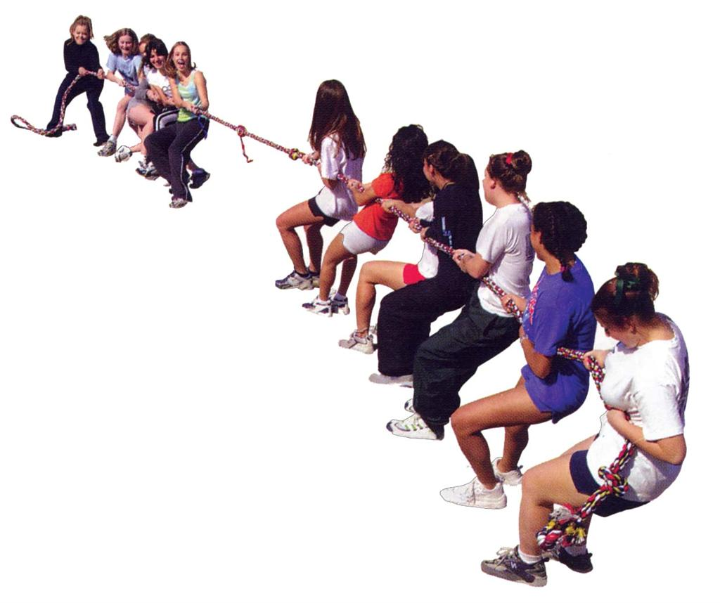
Muscle Teamwork
Skeletal muscles work together in synchrony to produce a desired movement
Kinesiology Books Publisher 6

Slide 7
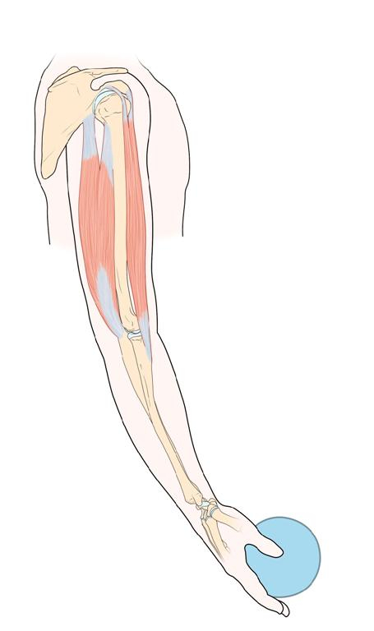
Agonist - Antagonist
FLEXION
Prima mover / agonist contracts: biceps
Antagonist relaxes: triceps
EXTENSION
Prime mover / agonist contracts: triceps
Antagonist relaxes: biceps
Kinesiology Books Publisher 7

Slide 8
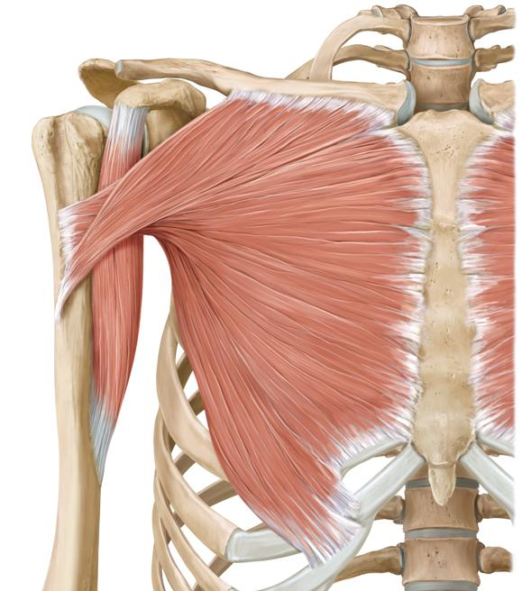
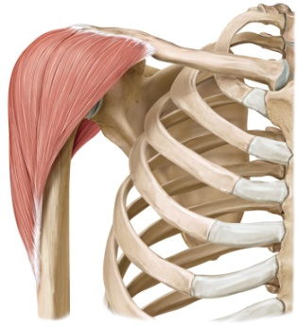
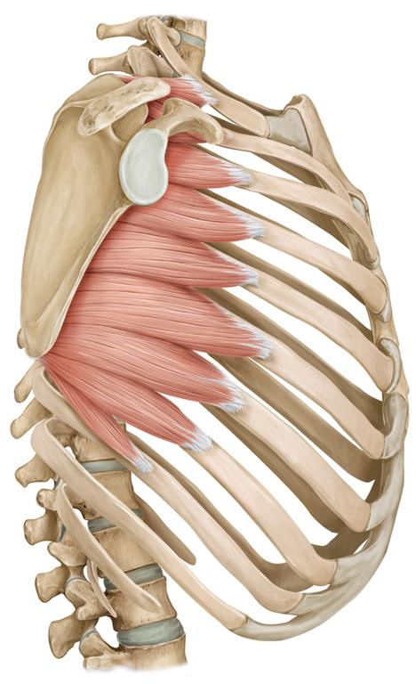
SYNERGISTS AND FIXATORS
EXAMPLE: Rope climbing
Prime mover / agonist contracts to flex shoulder: pectoralis major
Synergist contracts to complement flexion: deltoid anterior
Fixator contracts to steady scapula closer to body: serratus anterior
Kinesiology Books Publisher 8

Slide 9
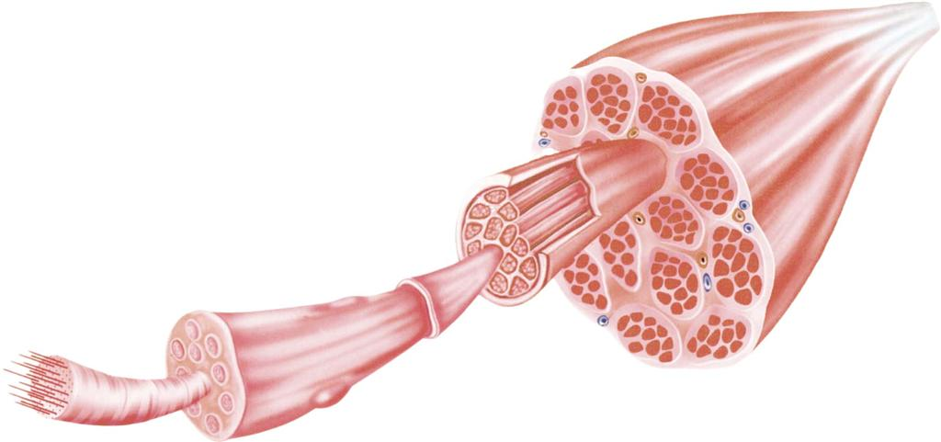
Structure
Muscle belly and cells
Contractile units
Kinesiology Books Publisher 9

Slide 10
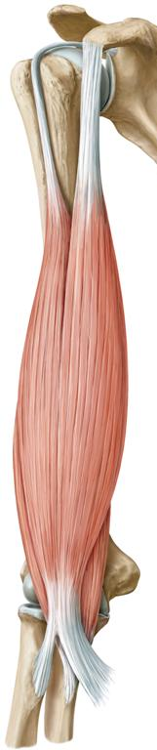
Muscle Fibre Bundle
Numerous muscle fibres wrapped by a thick connective tissue
Muscle belly
Made up of muscle fibre bundles
Muscle fibre
Cylinder-shaped muscle cell
Contains contractile machinery and organelles for cell respiration
Myofibrils
Make up muscle fibre
Contain contractile machinery: sarcomeres and myofilaments
Tendon
Attaches muscle belly to bone
Sarcolemma
Connective tissue sheath
Wraps each muscle fibre
Kinesiology Books Publisher 10

Slide 11
The Contractile Machinery
Myofibril
Sarcomere
Sarcomere
Myofibril contains contractile machinery:
Sarcomeres
Contractile units
Organized longitudinally in series (end to end)
Myofilaments
Thin filaments with actin proteins
Thick filaments with myosin proteins
Kinesiology Books Publisher 11

Slide 12
Thin filament
Actin
molecules
Actin
strand
Troponin
Tropomyosin
Sarcomere
MYOFIBRIL
Myosin head
Myosin tail
Thick filament
Myosin molecule
Kinesiology Books Publisher 12

Slide 13
Z line:
Proteins anchoring
thin filaments
Skeletal muscle = striated muscle
Alternating light and dark bands under microscope
Due to organization of sarcomeres and myofilaments
Sarcomere
Z line:
Proteins anchoring
thin filaments
H zone: space between thin filaments
M line:
Proteins anchoring
thick filaments
I band: Actin filaments
A band:
Myosin filaments
I band: Actin filaments
Kinesiology Books Publisher 13

Slide 14
Thin filament
Z line
Sarcomere
H zone
M line
Z line
Thick filament
Kinesiology Books Publisher 14

Slide 15
Sliding Filament Theory
Muscle contraction occurs due to actin sliding over myosin:
Motor nerve activates muscle fibre
Myosin head attaches to actin; cross bride formation
Cross bridges move similar to stroking of the oars
Actin filaments move and sarcomere shortens
1% of sarcomere
25-40% of myofibril length
I band and H zone shrink, while A band remains the same
Kinesiology Books Publisher 15

Slide 16
A band
H zone
I band
A band
H zone
I band
I band
Kinesiology Books Publisher 16

